Slide 1
Data Mining
Ch 6: Mining Frequent Patterns, Associations, and Correlations - 2
Wan D. Bae, Ph.D.
baewd@hanyang.ac.kr

Slide 2
Scalable Frequent Itemset Mining Methods
Apriori: A Candidate Generation-and-Test Approach
Improving the Efficiency of Apriori
FPGrowth: A Frequent Pattern-Growth Approach

Slide 3
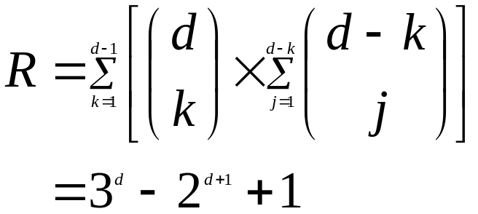
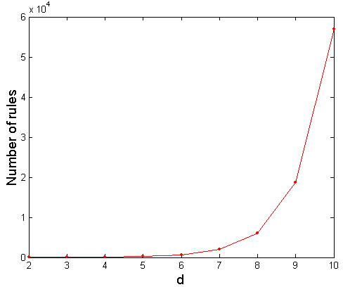
Computational Complexity
Given d unique items:
  Total number of itemsets = 2^{d}
  Total number of possible association rules:
If d=6, Itemsets: 64
If d=6, R = 602 rules

Slide 4
Factors Affecting Complexity
Choice of minimum support threshold
  lowering support threshold results in more frequent itemsets
  this may increase number of candidates and max length (k) of frequent itemsets
Dimensionality (the number of items) of the data set
  more space is needed to store support count of each item
  if number of frequent items also increases, both computation and I/O costs may also increase
Size of database
  since Apriori makes multiple passes, run time of algorithm may increase with number of transactions
Average transaction width
  transaction width increases with denser data sets
  this may increase max length of frequent itemsets (number of subsets in a transaction increases with its width)

Slide 5
Challenges of Frequent Pattern Mining
Challenges
  Huge number of candidates
  Multiple scans of transaction database
  Tedious workload of support counting for candidates

Slide 6
Frequent Itemset Generation Strategies
Reduce the number of candidates (M)
  Complete search: M=2^{d}
  Shrink number of candidates
    Use pruning techniques to reduce M (in Apriori)
Reduce the number of transactions scanned (N)
  Reduce passes of transaction database scans
  Used by Dynamic Hashing and Pruning (DHP)
Reduce the number of comparisons (NM)
  Facilitate support counting of candidates
  Use efficient data structures to store the candidate itemsets or transactions
  No need to match every candidate against every transaction

Slide 7


Illustrating the Apriori Principle
Given d unique items, there are 2^{d} possible candidate itemsets
Found to be Infrequent
Pruned supersets

Slide 8
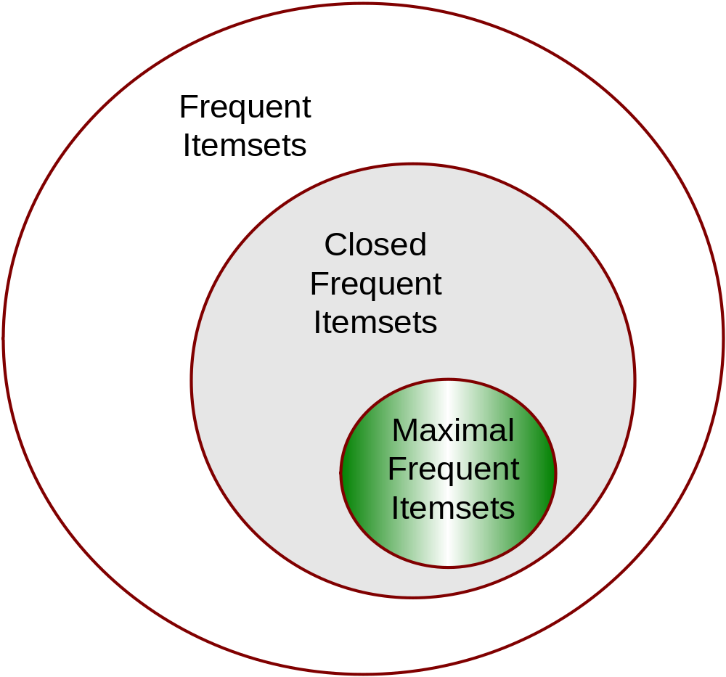
Maximal vs Closed Itemsets

Slide 9
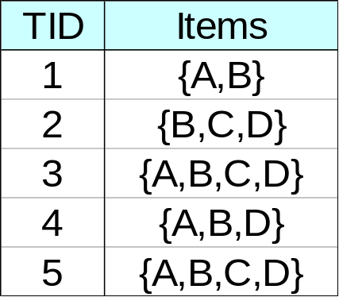
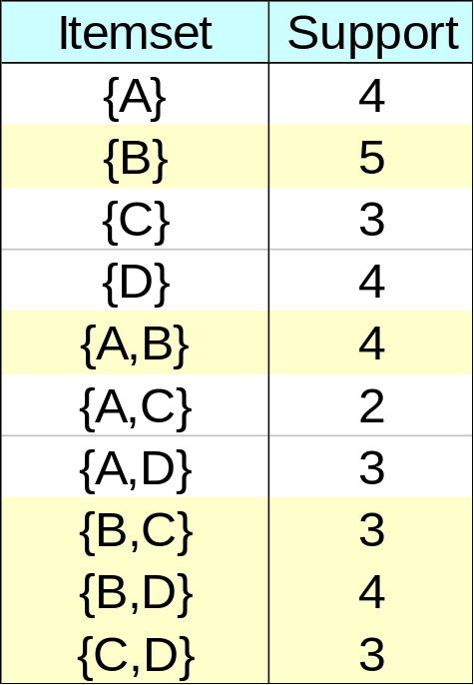
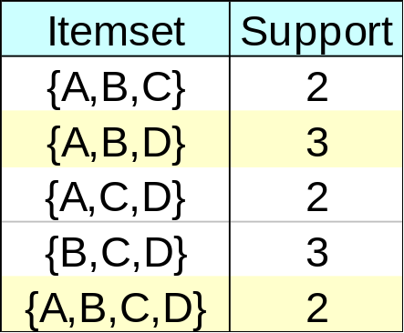
Closed Frequent Itemset
An itemset is closed if none of its immediate supersets has the same support as the itemset
{B,C}
3
3
{C, D}
Frequent itemtsets

Slide 10
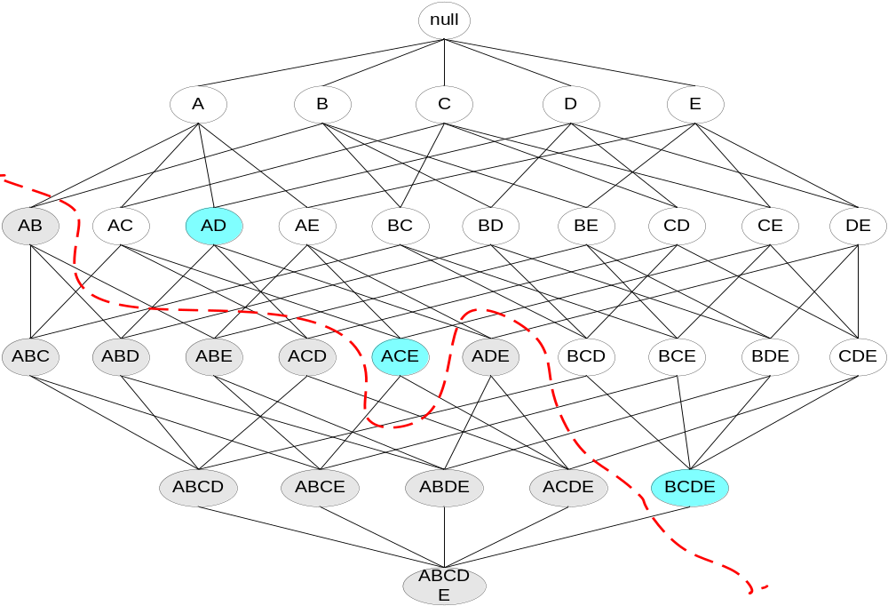
Maximal Frequent Itemset
An itemset is maximal frequent if none of its immediate supersets is frequent
Maximal Itemsets
Infrequent Itemsets
Border

Slide 11
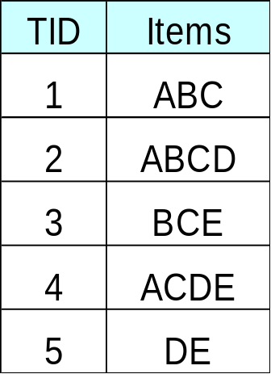

Maximal vs Closed Itemsets
3
3
4
3
3
2
3
2
1
3
1
1
2
2
2
min_sup = 2
2
1
0
2
1
1
1
1
0
1
1
0
0
1
0
For each itemset, scan DB and have the support count
0

Slide 12
Maximal vs Closed Itemsets
3
3
4
3
3
2
3
2
1
3
1
1
2
2
2
min_sup = 2
2
1
0
2
1
1
1
1
0
1
# Closed = 9
# Maximal = 4
1
0
0
1
0
0

Slide 13
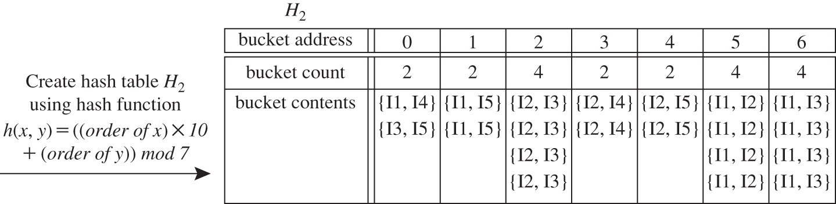
Reduce the Number of Candidates in C_{k}
Dynamic Hashing and Pruning (DHP Algorithm)
  Candidate large 2-itemsets are huge → Trim them using hashing
A k-itemset whose corresponding hashing bucket count is below the threshold cannot be frequent
Ex: H₂ for candidate 2-itemsets (min_sup = 3)
  This hash table was generated by scanning Table 6.1’s transactions while determining L₁
  The itemsets in buckets 0, 1, 3, and 4 cannot be frequent and so they should not be included in C₂

Slide 14
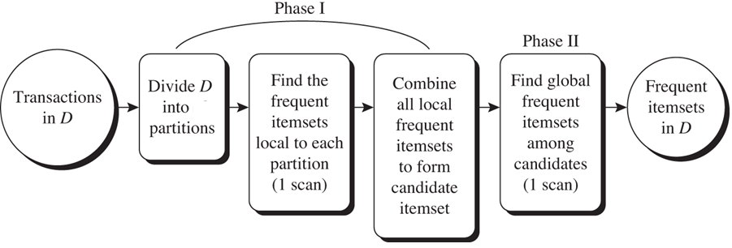
Partitioning: Scan Database Only Twice
Any itemset that is potentially frequent in DB must be frequent in at least one of the partitions of DB
  Scan 1: partition database and find local frequent patterns
  Scan 2: consolidate global frequent patterns
n

Slide 15
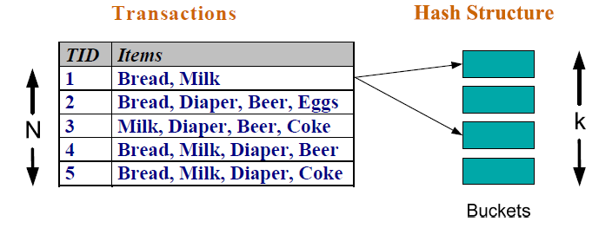
Reducing Number of Comparisons
To reduce the number of comparisons for determine the support of each candidate itemset:
  Instead of matching each transaction against every candidate, match it against candidates contained in the hashed buckets
Method:
  Candidate itemsets are stored in a hash-tree
  Leaf node – contains a list of itemsets
  Interior node – contains a hash table
Each of bucket is leaf node

Slide 16
Example of the Hash-tree for C₃
Suppose you have 13 candidate itemsets of length 3:
{1 4 5}, {1 2 4}, {4 5 7}, {1 2 5}, {4 5 8}, {1 5 9}, {2 3 4}, {5 6 7}, {3 4 5},
{3 5 6}, {6 8 9}, {3 6 7}, {3 6 8}
Hash function: mod 3
H
Hash on 1st item
H
H
2 3 4
5 6 7
H
Hash on 2nd item
1, 4, 7
2, 5, 8
3, 6, 9
1 4 5
null
3 4 5
3 5 6
6 8 9
3 6 7
3 6 8
Leaf node is bucket
H(inner node) is hash function
H
Hash on 3rd item
1 2 4
4 5 7
1 2 5
4 5 8
1 5 9
Max leaf size: max number of itemsets stored in a leaf node (if number of candidate itemsets exceeds max leaf size, split the node)

Slide 17
Example of the Hash-tree for C₃
Hash function: mod 3
H
1 2 3 4 5
2 3 4 5
look for 2 X X
1, 4, 7
2, 5, 8
3, 6, 9
H
Hash on 1st item
1 2 3 4 5
look for 1 X X
3 4 5
look for 3 X X
H
2 3 4
5 6 7
H
Hash on 2nd item
1 4 5
null
3 4 5
3 5 6
6 8 9
3 6 7
3 6 8
H
Hash on 3rd item
1 2 4
4 5 7
1 2 5
4 5 8
1 5 9

Slide 18
Example of the hash-tree for C₃
Hash function: mod 3
1 2 3 4 5
H
2 3 4 5
look for 2 X X
1, 4, 7
2, 5, 8
3, 6, 9
1 2 3 4 5
look for 1 X X
Hash on 1st item
H
3 4 5
look for 3 X X
H
2 3 4
5 6 7
H
Hash on 2nd item
1 2 3 4 5
look for 1 4 X
1 4 5
null
3 4 5
3 5 6
6 8 9
3 6 7
3 6 8
∅
1 2 3 4 5
look for 1 2 X
H
Hash on 3rd item
1 2 4
4 5 7
1 2 5
4 5 8
1 5 9
1 2 3 4 5
look for 1 3 X (null)‏
The subset function finds all the candidates contained in a transaction:
At the root level it hashes on all items in the transaction
At level i it hashes on all items in the transaction that come after item the i-th item

